Slide 1
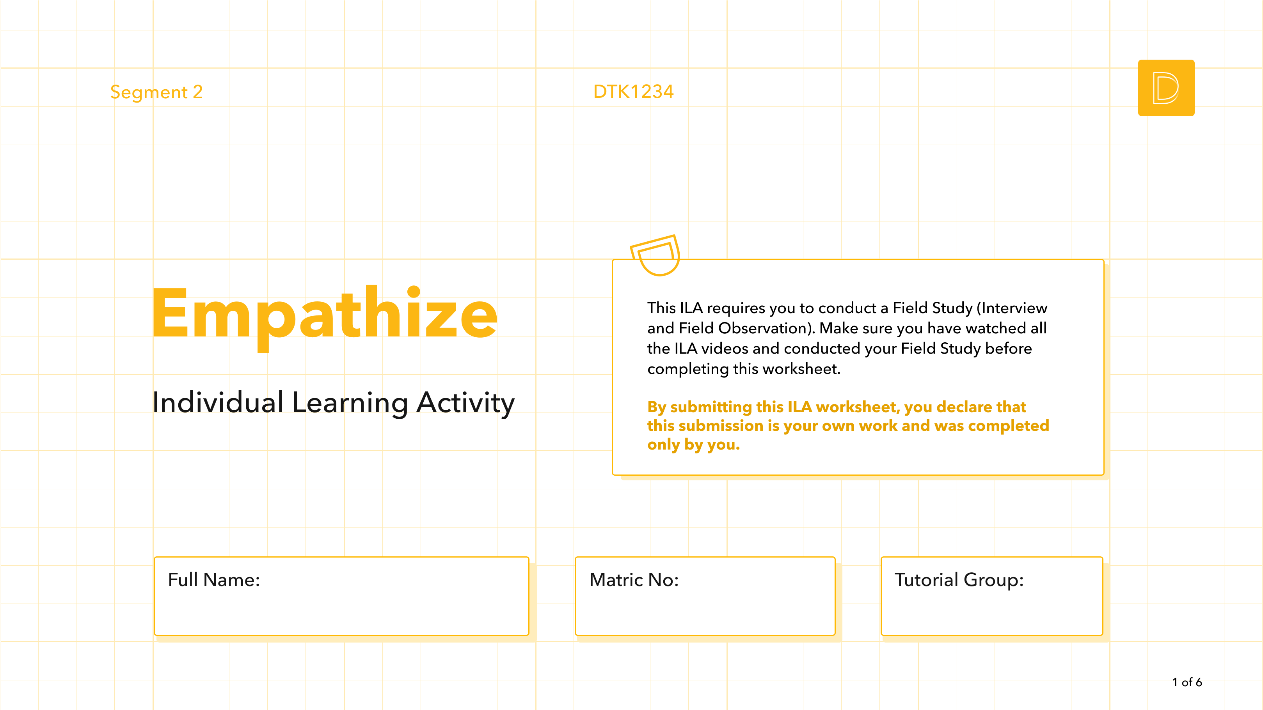
[Type here]
[Type here]
[Type here]

Slide 2
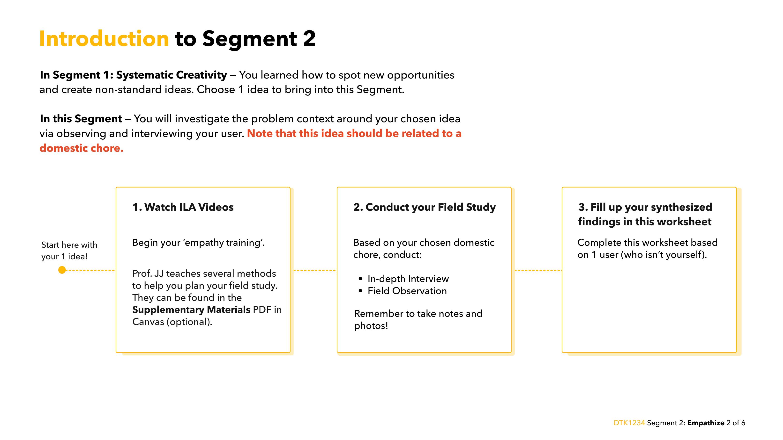

Slide 3
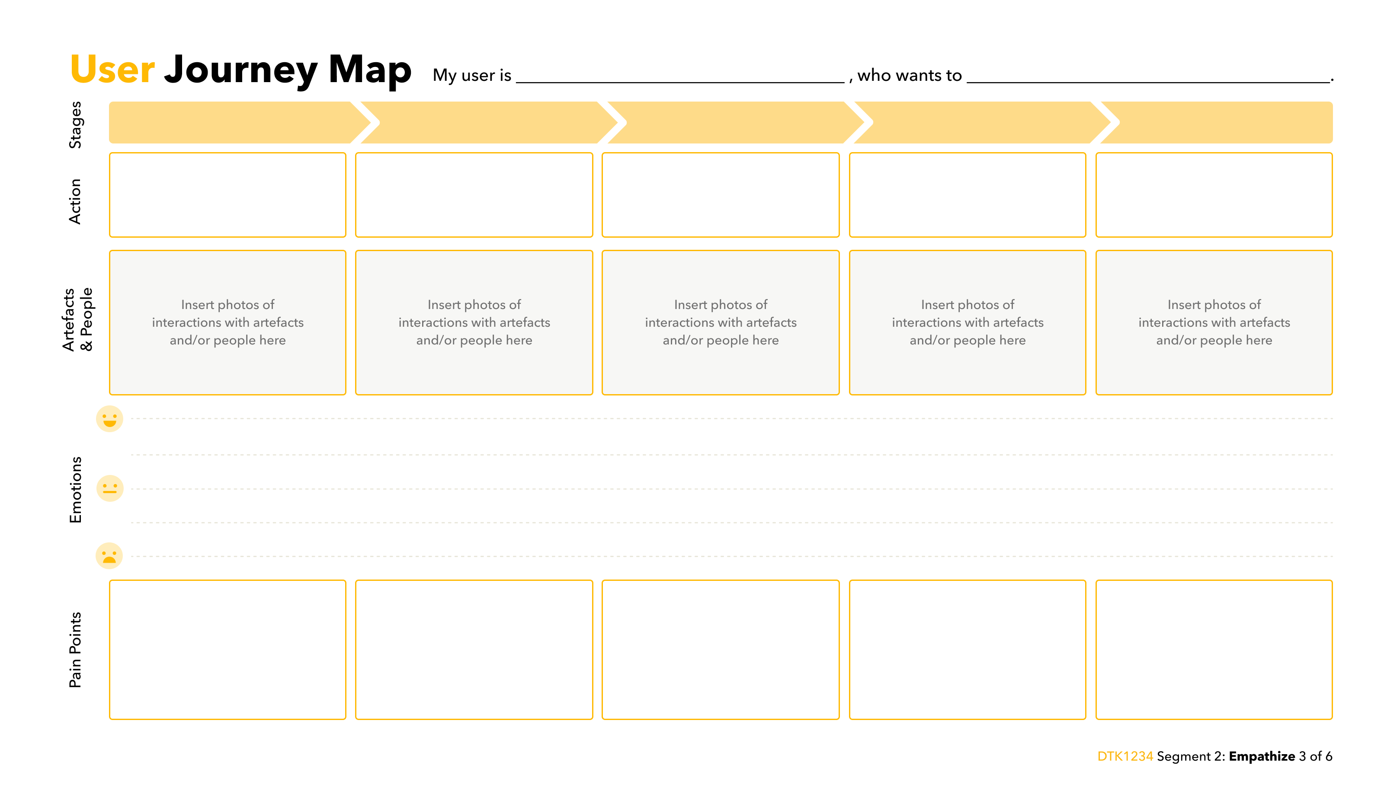



[age, gender, household role]
[chore-related goal]
[e.g. Preparing to go out]
[e.g. Walking the dog]
[e.g. Cleaning up]
[Action]
[Action]
[Action]
[Action]
[Action]
[Emotion]
[Emotion]
[Emotion]

Slide 4
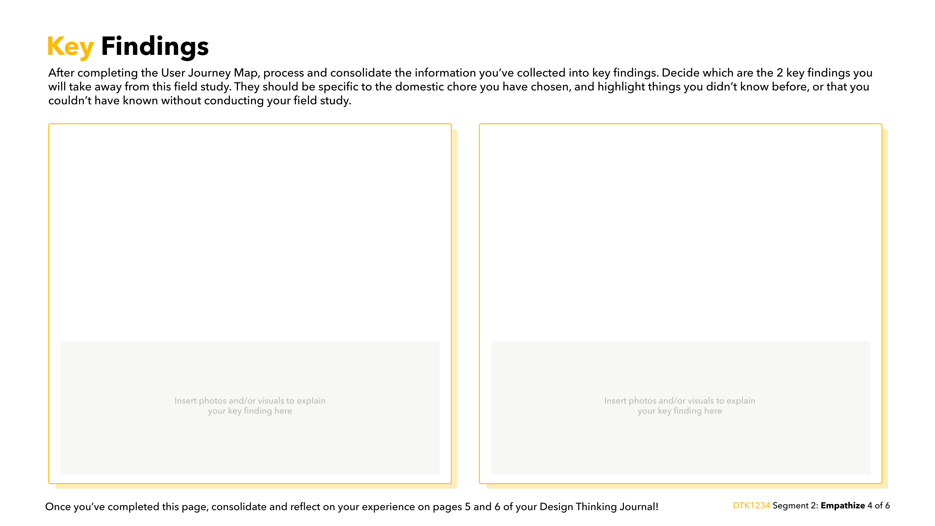
[Describe and explain your first key finding clearly and in detail here.
Tell us what you have realized and what the issue is.]
[Describe and explain your second key finding clearly and in detail here. Tell us what you have realized and what the issue is.]

Slide 5
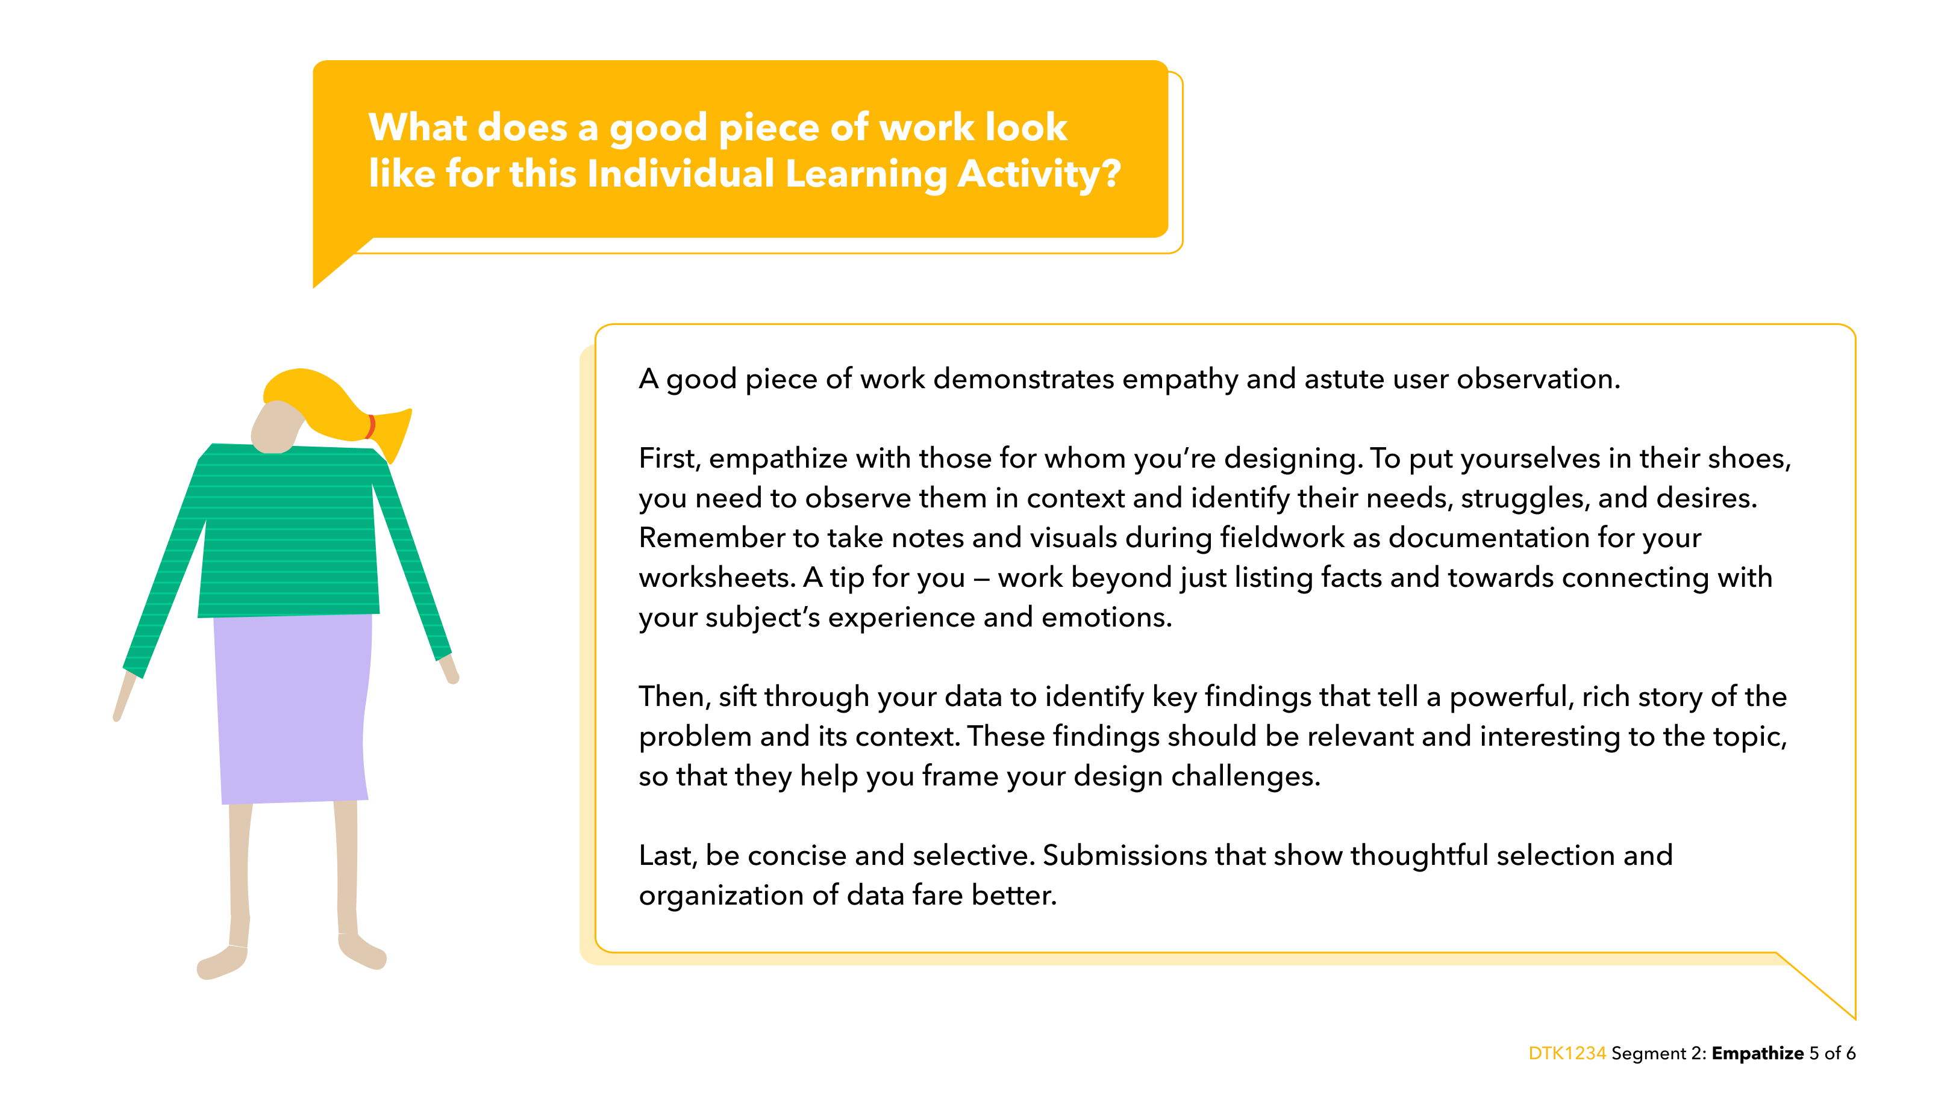

Slide 6
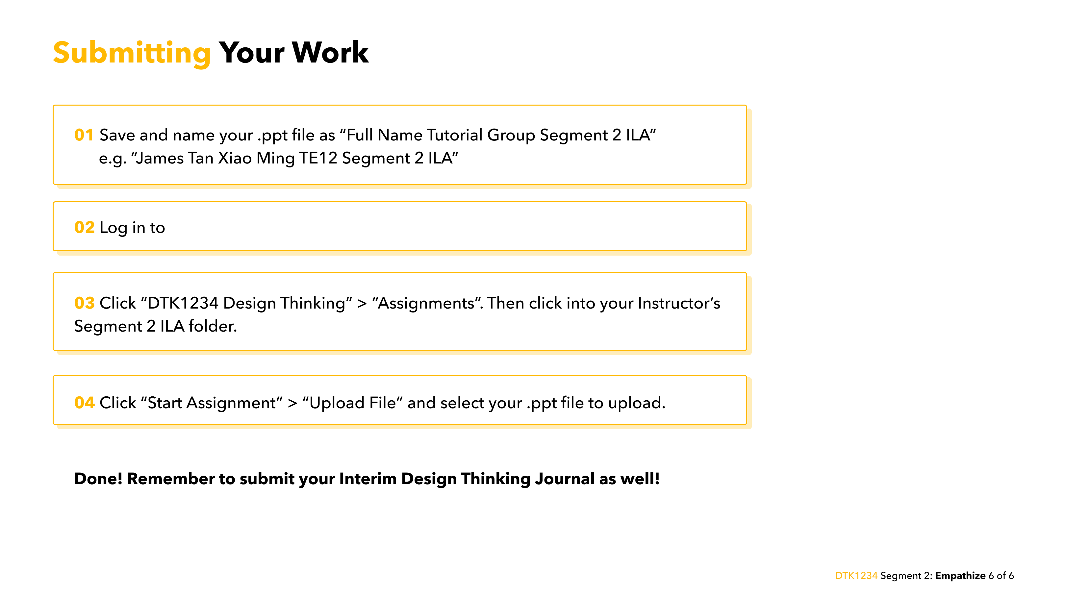
https://canvas.nus.edu.sg/
Notes:
https://canvas.nus.edu.sg/

